Slide 1

File Encryption Tool
A Simple, Secure GUI for File Encryption & Decryption
Created by:
Rupak Kumar (12221403)
Rudransh Raj Heera(12219684)
Live App
GitHub Repo

Slide 2
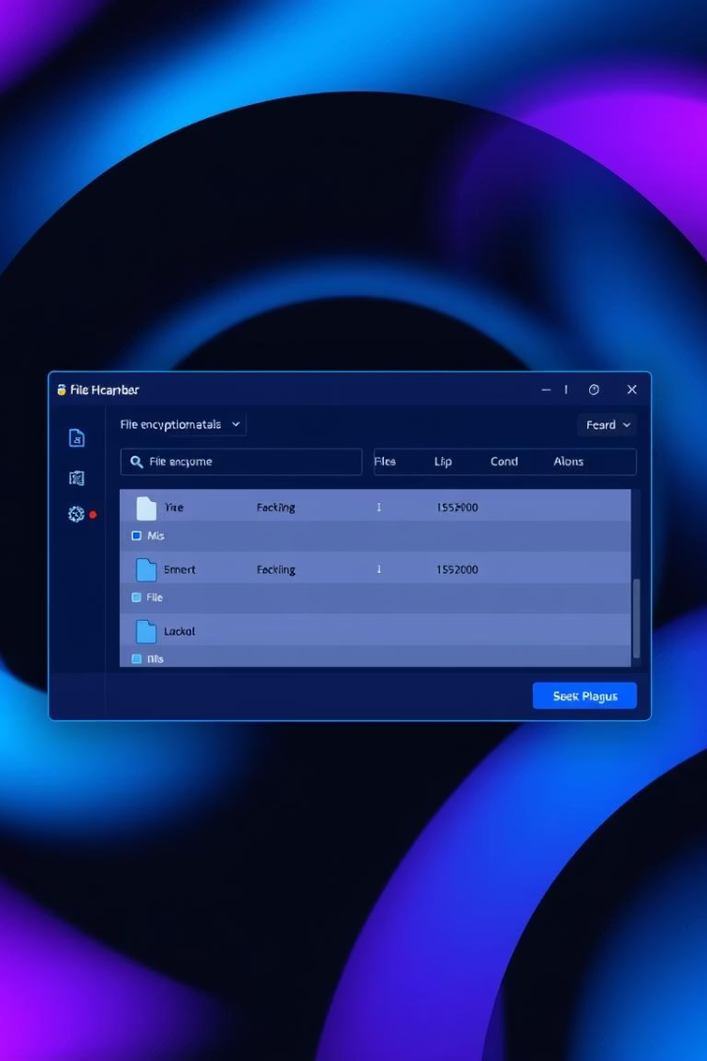
Introduction: What is File Encryptor GUI?
File Encryptor GUI is a minimal, cross-platform file encryption tool built using Python and Tkinter.
It is designed to encrypt any file securely, decrypt encrypted files easily, and check password strength in real time. It provides a simple and effective method to protect your sensitive information.
The application is available on Windows, MacOS, and Linux.
Encrypt Files
Decrypt Files
Securely encrypt any file type to protect your data.
Easily decrypt files with the correct password.
Password Strength
Real-time feedback on password security.

Slide 3




Key Features
File Encryptor GUI provides top-tier data protection through robust encryption standards and a user-friendly interface. Some of the features are:
AES Encryption
Utilizes AES encryption via cryptography and Fernet for robust security.
PBKDF2 + SHA256
Employs PBKDF2 with SHA256 for secure key derivation.
User-Friendly Interface
Intuitive design for easy navigation and operation.
Furthermore, the application offers cross-platform compatibility on Windows, macOS, and Linux, along with real-time password strength checking for added security.

Slide 4
Security Details
Security is the main concern, and File Encryptor GUI offers enterprise-grade protection.
AES 256-bit Encryption
Key Derivation
AES-256 bit encryption strength provides state-of-the-art data security. This encryption algorithm is virtually unbreakable.
PBKDF2 with SHA256 is used to securely derive encryption keys from user-provided passwords. This protects against dictionary attacks.
The security features combine to ensure that your encrypted data remains safe from unauthorized access. With its advanced encryption techniques and secure key derivation methods, File Encryptor GUI offers a high level of protection for your files.

Slide 5
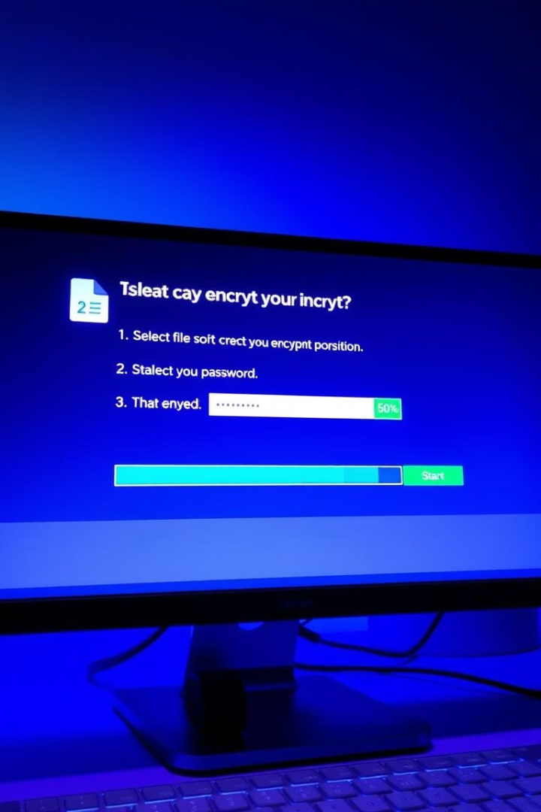



How to Use
Encrypting or decrypting your files is a straightforward process with File Encryptor GUI.
Select File
Choose the file you wish to encrypt or decrypt.
Enter Password
Input your password and confirm it.
Start Process
Initiate the encryption or decryption.
The application provides clear prompts and progress indicators throughout the process. The user-friendly design of File Encryptor GUI ensures that even users without technical expertise can easily secure their files.

Slide 6

Behind the Scenes
File Encryptor GUI uses AES encryption to convert the data into an unreadable format. Here is a short description of what happens under the hood:
Key Generation
Data Transformation
A unique encryption key is derived from your password using PBKDF2 + SHA256.
The selected file's data is transformed using the AES encryption algorithm.
Secure Storage
The encrypted file is stored with a .encrypted extension, ensuring its protection.
These steps ensure that your file is securely encrypted and protected. The combination of robust encryption algorithms and secure key derivation methods makes File Encryptor GUI a reliable solution for safeguarding your sensitive information.

Slide 7




Contributing and Future Improvements
File Encryptor GUI is an open-source project, which means that anyone can contribute to its development and improvement. Community involvement is highly encouraged to make the tool even better.
Multi-File Encryption
Adding the ability to encrypt multiple files simultaneously.
Cloud Integration
Integrating with cloud storage services for seamless encryption and decryption.
Enhanced UI/UX
Improving the user interface and user experience.
By working together, the community can drive the tool's evolution and ensure that it remains a valuable asset for users seeking secure file encryption.

Slide 8

Conclusion
File Encryptor GUI offers a secure and easy way to protect your sensitive files. With its robust encryption, user-friendly interface, and cross-platform compatibility, it's an ideal solution for anyone looking to secure their data.
File Encryptor GUI is your go-to solution for secure and hassle-free file encryption. You can find the application on GitHub.
Access
Simplicity
Get the app on GitHub and start protecting your files today.
Security
Easy to use, even for beginners.
Rest easy knowing your files are safe.

